Slide 1
EMSE 6586
Final Project Presentation
Exploring Microsoft Azure Cosmos DB for Data Storage and Analysis
By:
Kishan Ramesh
G44387483

Slide 2

Introduction
Azure Cosmos DB is a fully managed NoSQL database service provided by Microsoft Azure. It's designed to scale globally, making it ideal for applications that require low-latency, high availability, and seamless scalability.
Cosmos DB supports various data models, including document, key-value, column-family, and graph, providing flexibility for different types of applications.
Azure Cosmos DB offers developers a powerful and reliable platform for building modern, data-intensive applications.

Slide 3
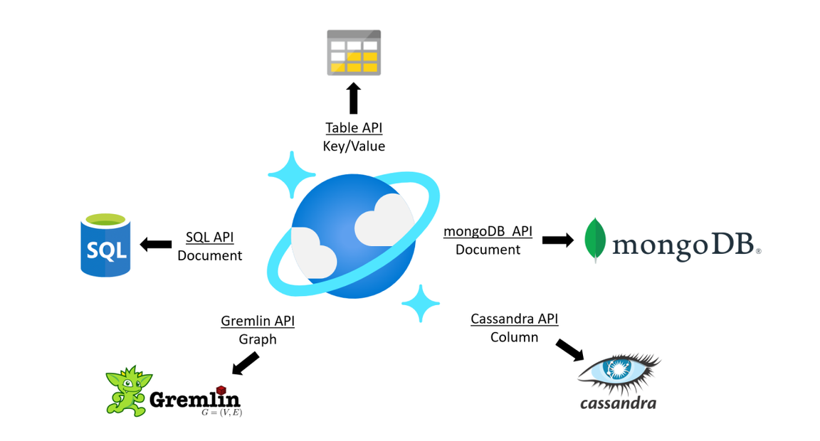
API Overview
Cosmos DB provides a comprehensive set of APIs to interact with its database service. They are NoSQL/Native API, Postgres SQL API, MongoDB API, Cassandra API, Gremlin API and Table API.
These APIs provide developers with flexibility and choice, allowing them to use the most appropriate API based on their application's requirements and existing technologies. In this project, NoSQL / Native API of Cosmos DB is explored for data storage and Analysis
The NoSQL API of Azure Cosmos DB provides a powerful and flexible way to interact with the database using SQL-like queries. It simplifies data access and manipulation, offering developers a familiar SQL-like interface to work with NoSQL data stored in Azure Cosmos DB.

Slide 4

Problem Statement
This project aims to evaluate the suitability of Microsoft Azure Cosmos DB for NoSQL as a data storage and analysis solution. The investigation will focus on the functionality of Cosmos DB in the context of data exploration and its comparative advantages and disadvantages relative to other database tools.

Slide 5

About the Dataset
The data utilized in this project comprises hierarchical information about countries, states, and cities, sourced from the internet. The dataset includes five JSON files that provide details on regions, sub-regions, countries, states, and cities worldwide. This data was last updated in February 2024.
The dataset is structured with 6 documents in Regions, 22 in Sub-Regions, 250 in Countries, 5084 in States, and 150,573 in Cities.
Dataset link

Slide 6

Methodology
The chosen dataset will be loaded into an Azure Cosmos DB for NoSQL instance. Subsequently, an analysis will be conducted to assess the features of Cosmos DB for data storage and retrieval capabilities within the context of data exploration tasks. The findings will be further substantiated by comparing Cosmos DB's performance with Mongo DB in the domain of data exploration.

Slide 7
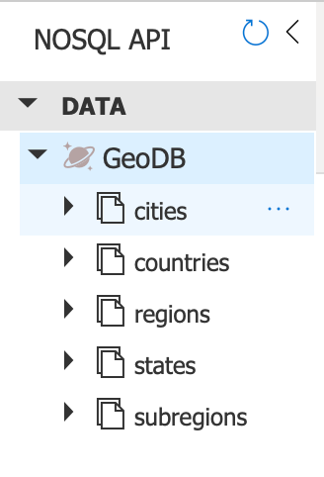
Database Creation and Data Ingestion
After configuring the Cosmos DB account, Python is used as coding environment and it connects to the account using the AzureCosmos Client library.
The "GeoDB" database is then established, containing 5 containers: Regions, Sub Regions, Country, States, and Cities, created using a Python function.
The Country-State-City hierarchy dataset is subsequently ingested into the database, with each document placed into its respective container using a Python function leveraging the json library.

Slide 8

Querying
Azure Cosmos DB NoSQL api uses SQL like syntax to retrive and manipulate data stored in the database. Here are some querying methods in Azure:
Select : "SELECT * from region r"
Filtering with Where : "SELECT * from states s WHERE s.country_name = 'United States'"
Ordering results : “SELECT * FROM city c ORDER BY c.name ASC”
Limiting results : “SELECT TOP 5 * FROM country c“
Filtering Nested Properties: “SELECT * FROM country c WHERE c.city = 'New York'”
Aggregating Data: “SELECT COUNT(1) AS count FROM states s”

Slide 9
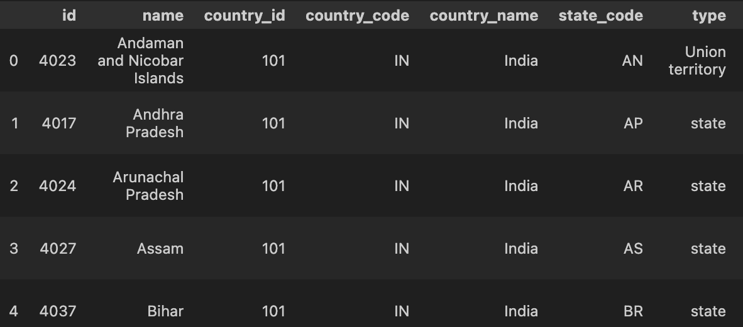
Example Query:
Query to get all states in India and sort them alphabetically
''' SELECT * from states s WHERE s.country_name = 'India' ORDER BY s.name '''

Slide 10
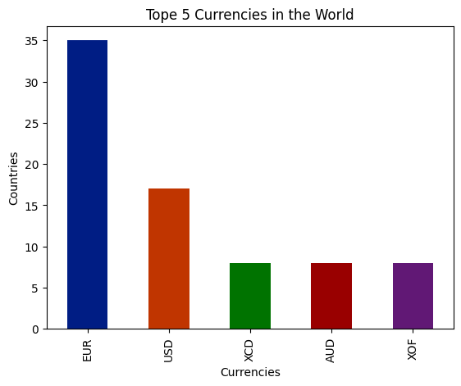
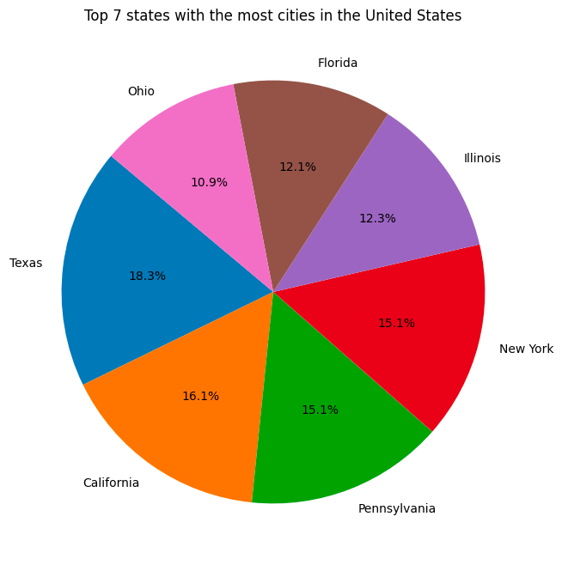
Visualizations:

Slide 11

Comparative Analysis with other Database tool
MongoDB, a document-oriented database, similar to Cosmos DB is employed as an additional database tool for assessing the performance of Azure Cosmos DB within the realm of data exploration.
Just like Cosmos DB, the MongoDB cluster is hosted on the Azure cloud platform using MongoDB Atlas, ensuring a standardized basis for comparison.
Following the creation of the cluster in MongoDB, the Python coding environment establishes a connection to the cluster using the pymongo library.
Subsequently, the GeoDB database is created, and the identical dataset is ingested into the MongoDB cluster.

Slide 12
Cosmos DB | Mongo DB
Fully managed database service by Microsoft Azure. | Open-source NoSQL database, available as both a self-managed version and a managed service called MongoDB Atlas.
Supports multiple data models, including document (JSON), key-value, graph (Gremlin), and column-family (Cassandra) | Primarily designed for the document data model (BSON format)
Built for global distribution with multi-region replication, ensuring low-latency access and high availability across regions. | Provides multi-region clusters for global availability, but it's not as deeply integrated with the underlying infrastructure for global distribution as Azure Cosmos DB.
Provides SQL-like query language for document data model | Uses MongoDB Query Language (MQL) for document queries, which is JSON-based
Containers cannot be joined directly using a single query in Cosmos DB | Collections can be joined using aggregate pipeline in Mongo DB

Slide 13
Conclusion
In conclusion, this project focuses on assessing the viability of Microsoft Azure Cosmos DB as a NoSQL data storage and analysis solution. It delves into the functionality of Cosmos DB concerning data exploration and compares its strengths and weaknesses against MongoDB.
The seamless global distribution and multi-model support of Azure Cosmos DB provides flexibility and scalability, allowing developers to choose the most suitable data model for their application needs. These advantages highlight Azure Cosmos DB's capability to meet the diverse requirements of modern data-driven applications effectively.

Slide 14


THANK YOU!

